Slide 1

Sunset Software
www.4331g8.xyz
Santiago alvarez
huu cao
Daniel foster
john francis kennedy
elaine ng
Christopher stephens
mark fritz

Slide 2
Table of contents
Team Members and Their Roles
Technology Used
Things that went well
Things that did not go well
Gantt Chart
UML Diagrams:
Use Case Diagram
Sequence Diagram
ERD
Database & SQL Injections
API
Front-End
Demonstrations:
API
Website
Questions?

Slide 3
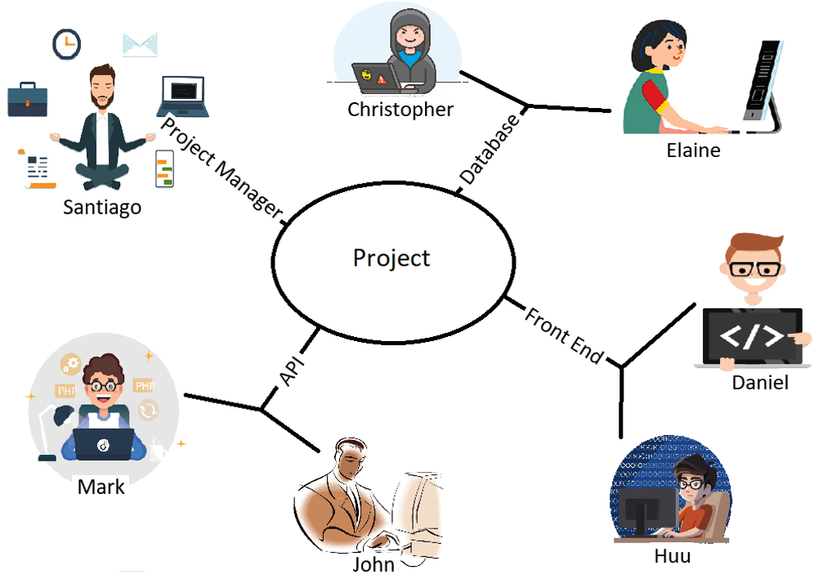
Team members
Project Manager:
Santiago Alvarez
Database:
Elaine Ng
Christopher Stephens
API:
John Francis Kennedy
Mark Fritz
Front End:
(Design) Daniel Foster
(JavaScript) Huu Cao

Slide 4
Technology
Web Hosting Services:
Azure
GoDaddy
Web Hosting Control Panel:
cPanel
MySQL Database
Repository:
GitHub
Communication Tools:
E-mail
Discord
Project Management Tools:
Trello
Team Gantt
API Testing Tools:
ARC (Advanced Rest Client)
Postman

Slide 5

Things that went well
Database Creation
API Testing
Communication:
Weekly Meetings
Attendance of all Members
Participations of all Members

Slide 6
Things that did not go well
Azure Difficulties:
Set Up
Complicated
Virtual Machine were Problematic
GoDaddy Difficulties:
DNS not Set up Correctly
Domain Parked
API Difficulties:
Search Endpoint

Slide 7
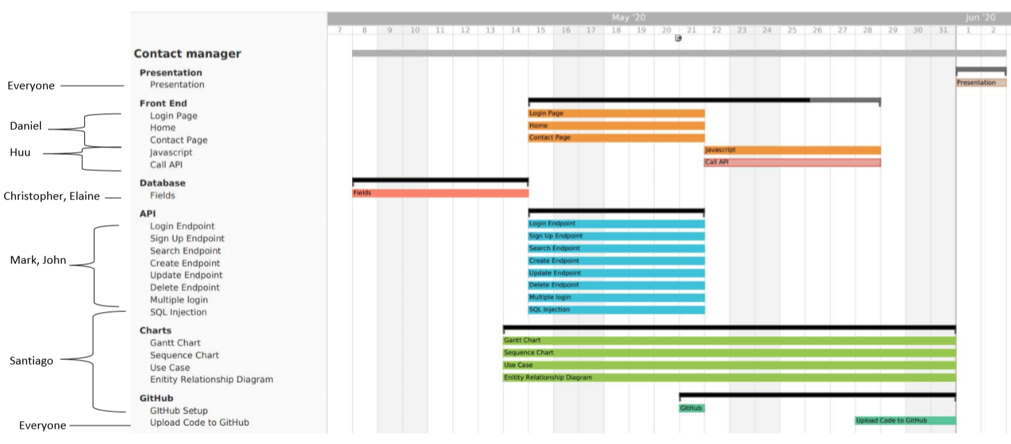
Gantt chart

Slide 8
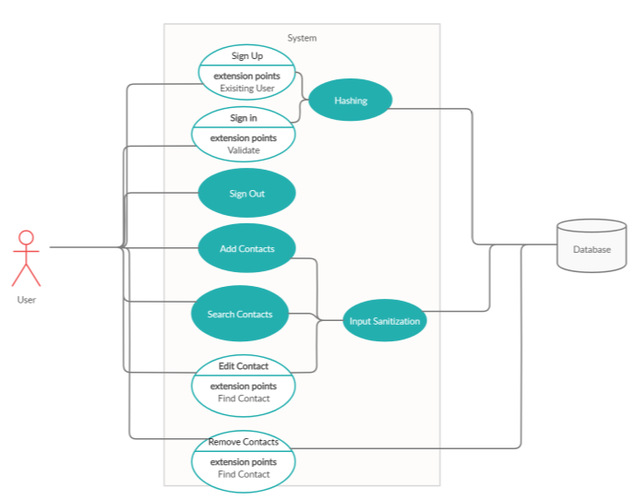
USE CASE DIAGRAM

Slide 9
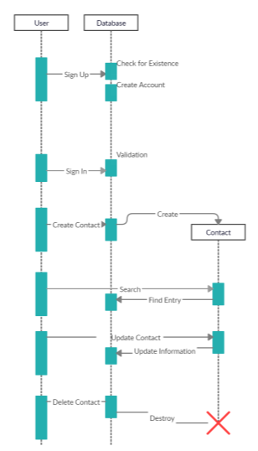
SEQUENCE DIAGRAM

Slide 10
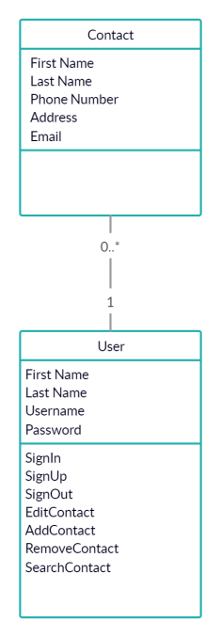
ERD
(ENTITY RELATIONSHIP DIAGRAM)

Slide 11
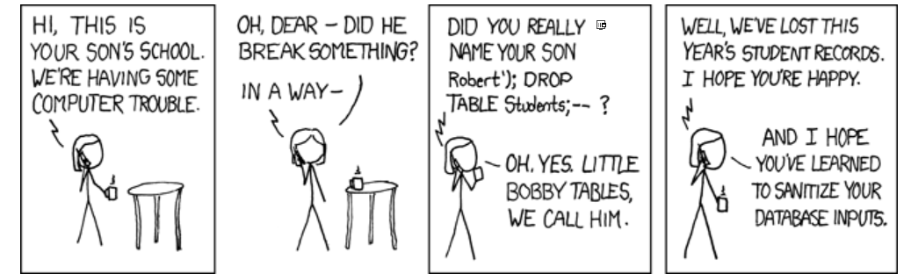
Database & sql injections
Tables:
Users:
ID, First Name, Last Name, Login & Password
Contacts:
ID, User ID, First Name, Last Name, Phone, E-mail & Creation Date
SQL Injection

Slide 12
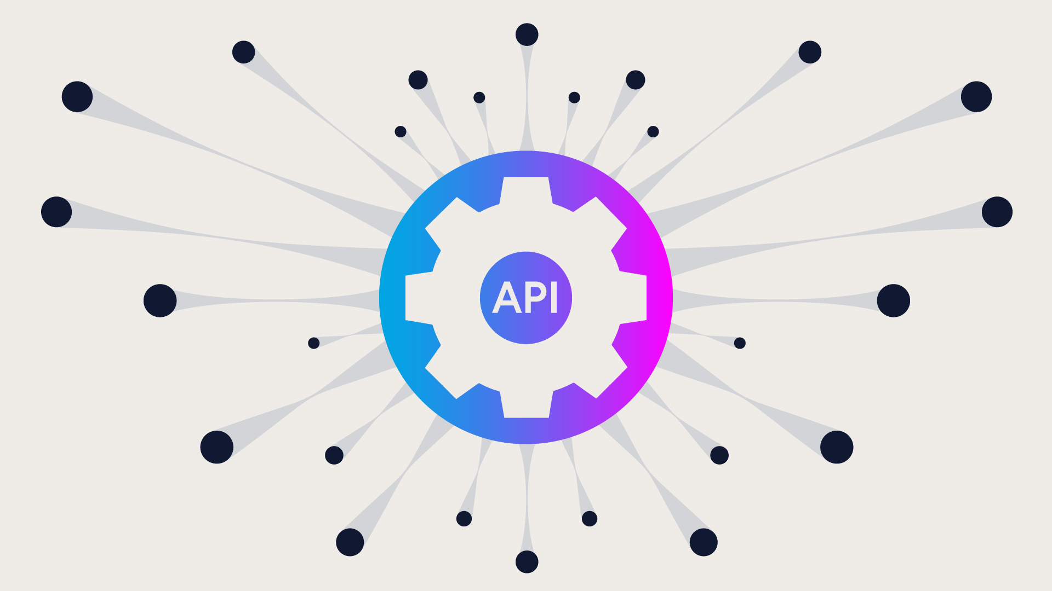
API
Programming Language:
Python → PHP
Completion Time:
4 Days
API Testing:
ARC
Postman
Endpoints:
Log In
Sign Up
Add Contact
Update Contact
Delete Contact
Search Contact

Slide 13
Front-end
Front-End Design
Languages Used:
HTML
CSS
JavaScript
Website Style Consistency
Coordination with Other Team Members
Attempted Website Creation Tools:
WordPress
Bootstrap
JavaScript
Call API
Front-End Function
Attempted JQuery

Slide 14
Demonstrations
API Demonstration
Website Demonstration

Slide 15

QUESTIONS?

